Slide 1
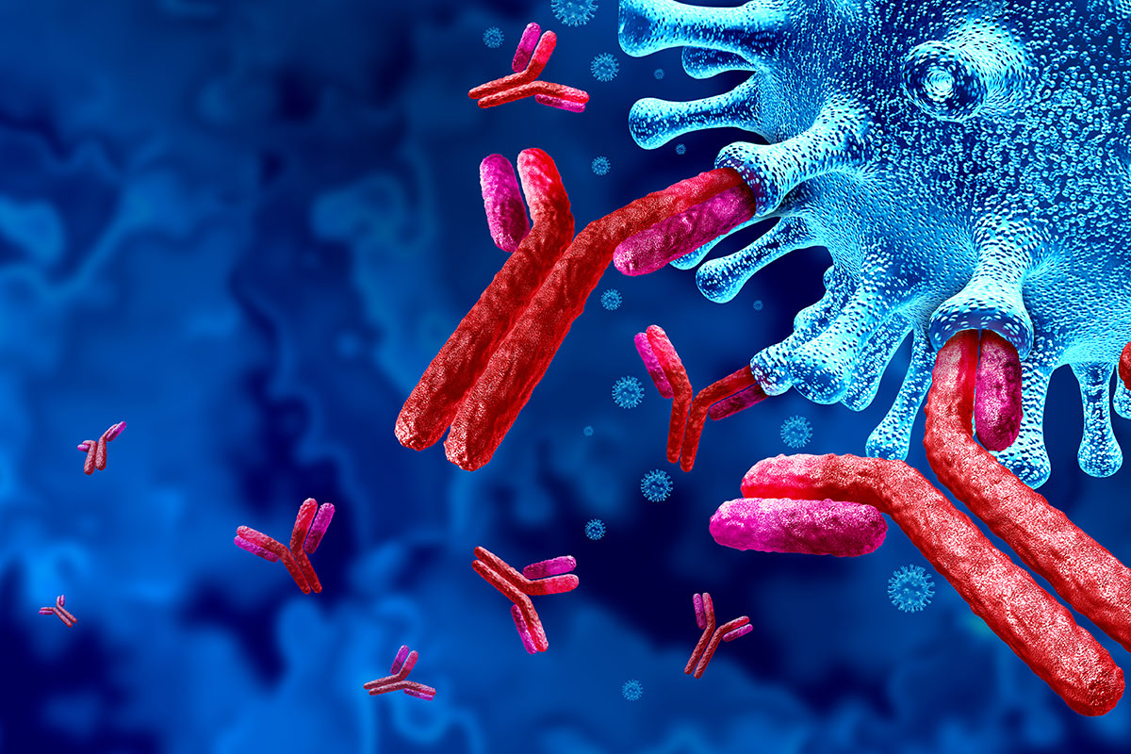
Microscale Modelling of Antibody Dependent Cellular Cytotoxicity
Luke Heirene
Helen Byrne
Eamonn Gaffney
James Yates

Slide 2
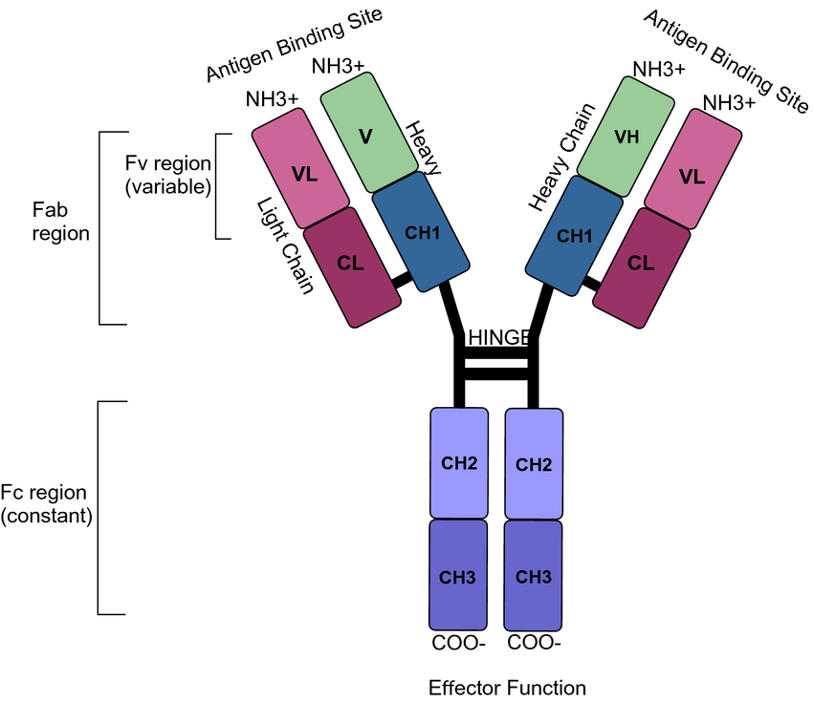
Mark JKK, Lim CSY, Nordin F, Tye GJ. Expression of mammalian proteins for diagnostics and therapeutics: a review. Mol Biol Rep. 2022 Nov;49(11):10593-10608. doi: 10.1007/s11033-022-07651-3. Epub 2022 Jun 8. PMID: 35674877; PMCID: PMC9175168.

Slide 3
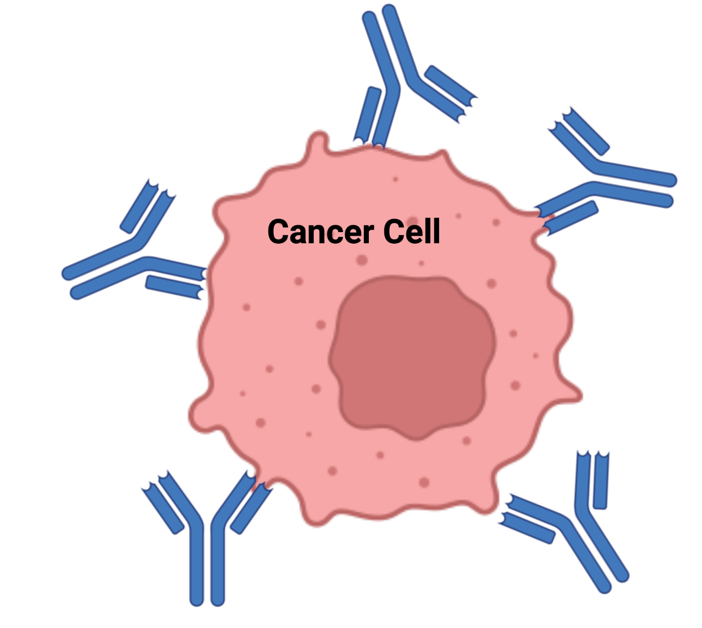
Why Monoclonal Antibodies (mabs)?
VERSATILITY
Cancer
Alzheimer’s disease
Autoimmune diseases
Standard mab therapy
Radioimmunotherapy
ADCs
Checkpoint therapy

Slide 4
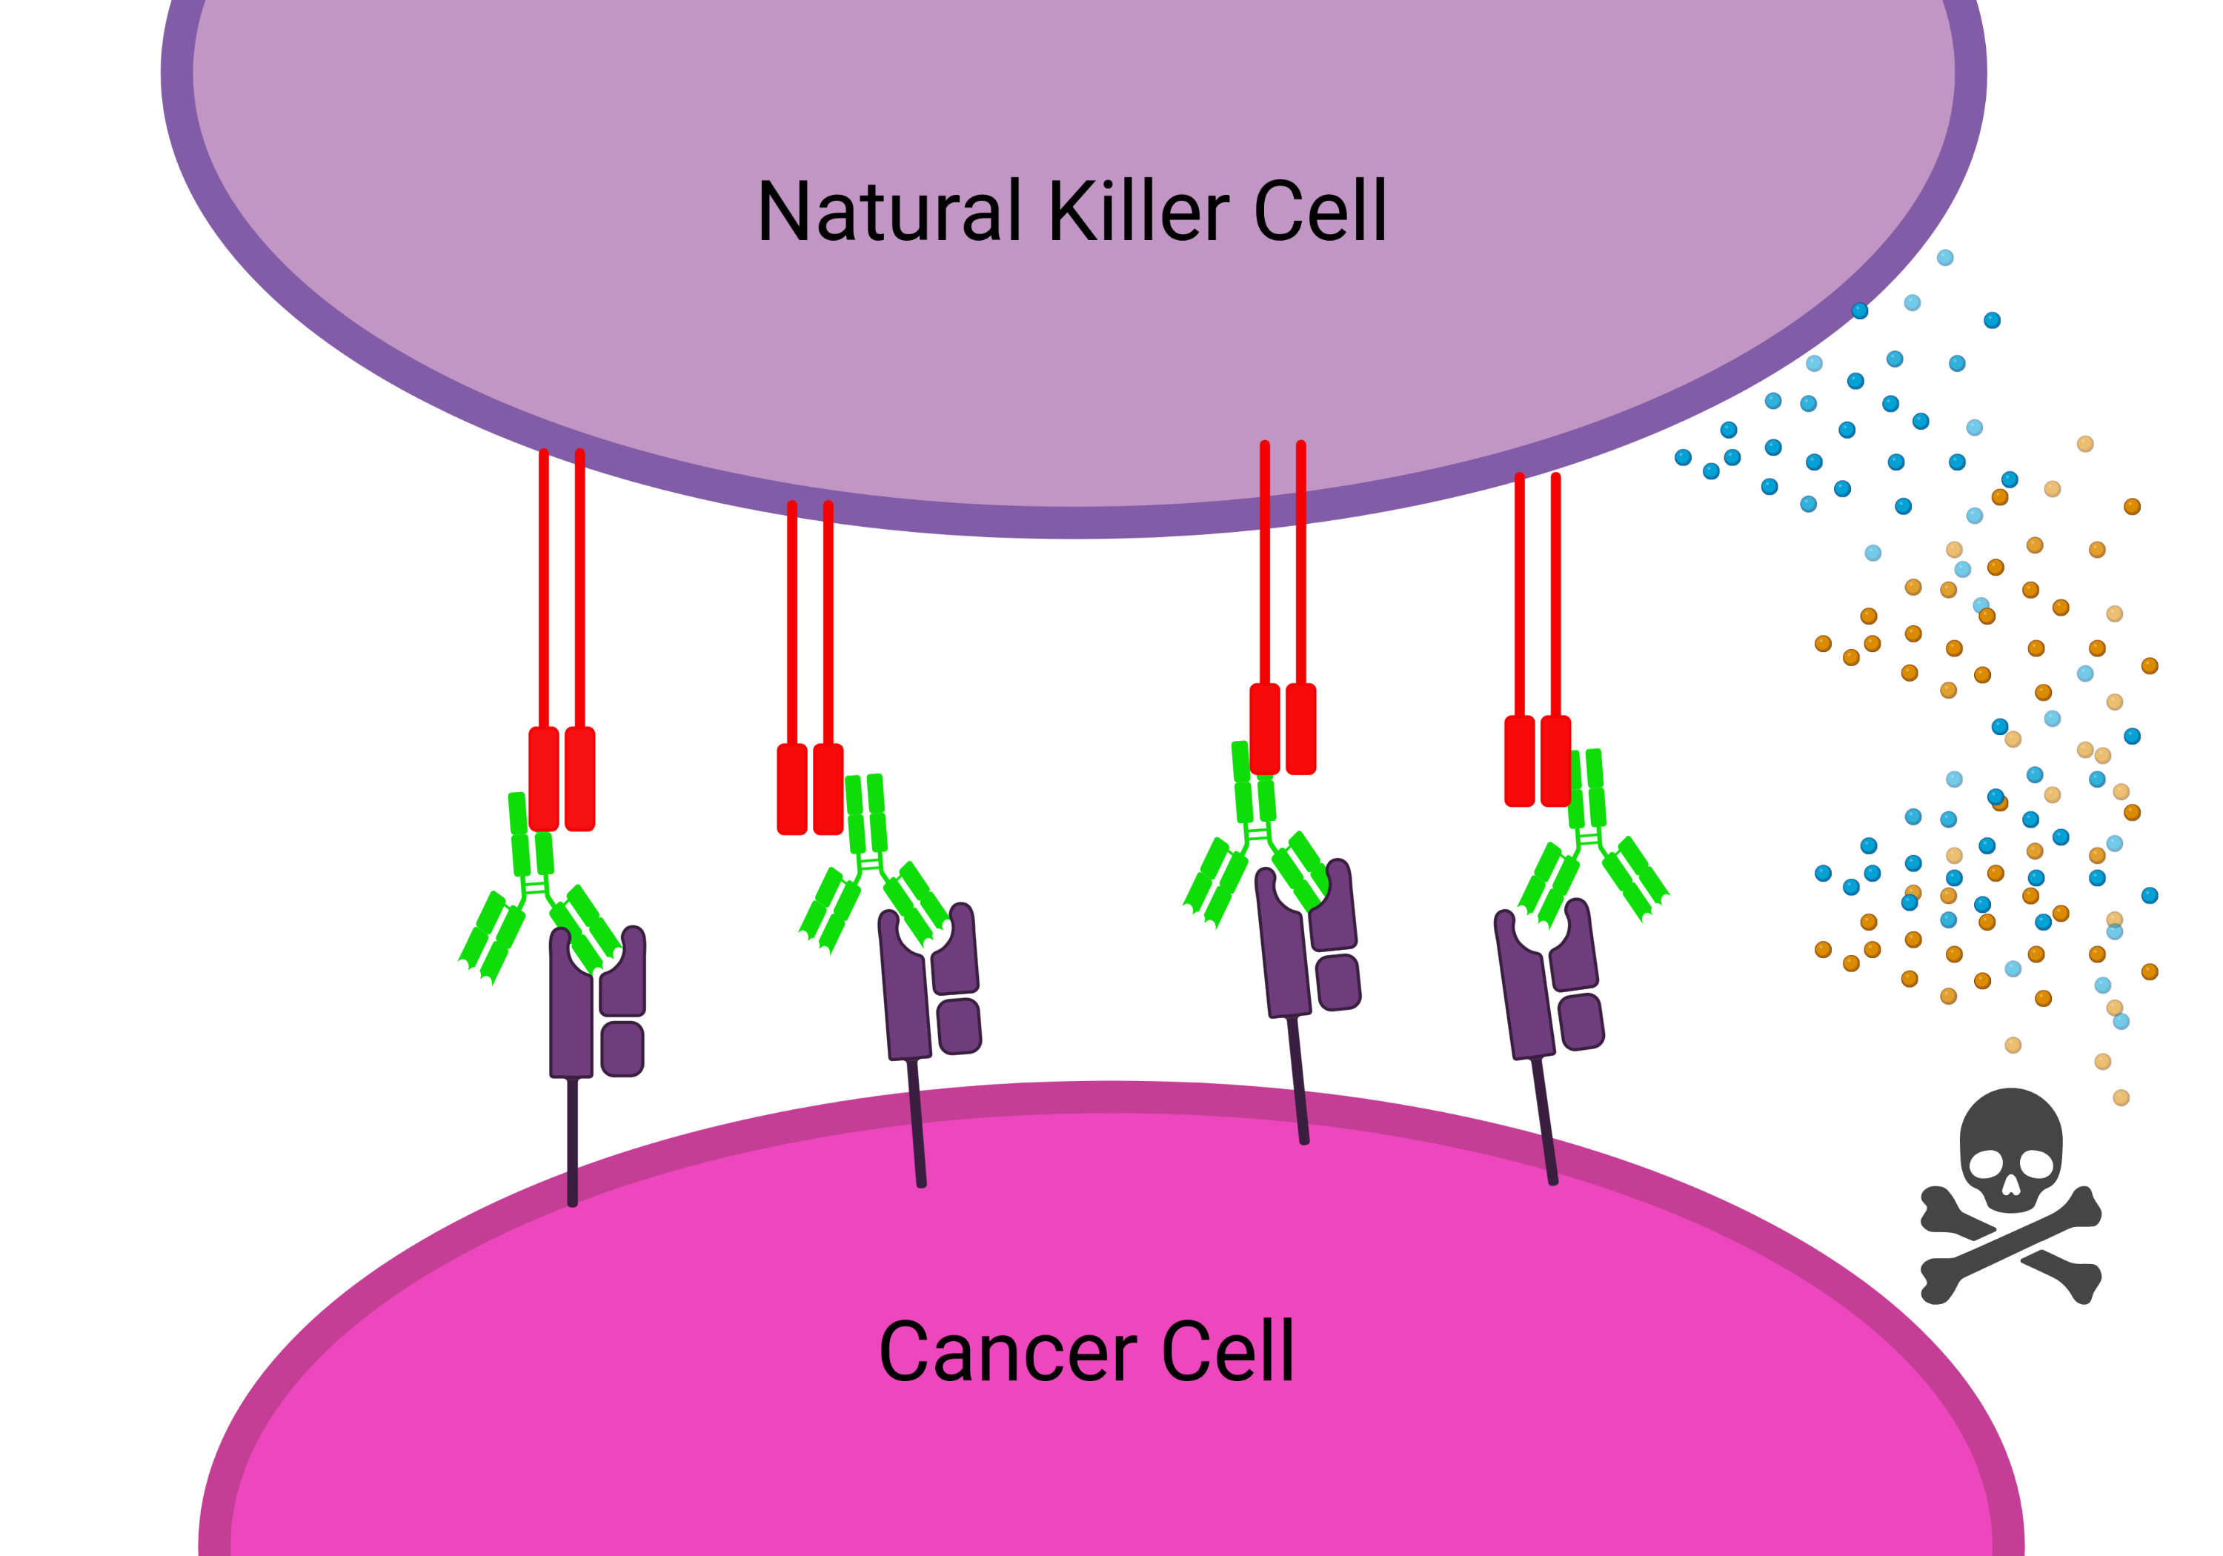
What is ADCC?
Mabs exert their effects through effector functions
Antibody-dependent cellular cytotoxicity guides the immune system to attack the tumour

Slide 5
Multiscale Processes affect ADCC
Microscale (receptor level dynamics)
ADCC
Macroscale (cell-cell interactions)

Slide 6
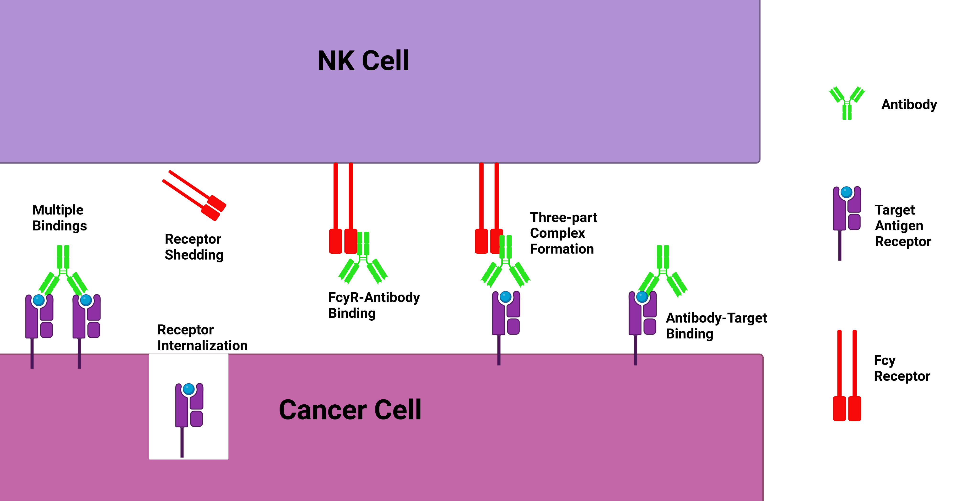
Microscale Dynamics

Slide 7
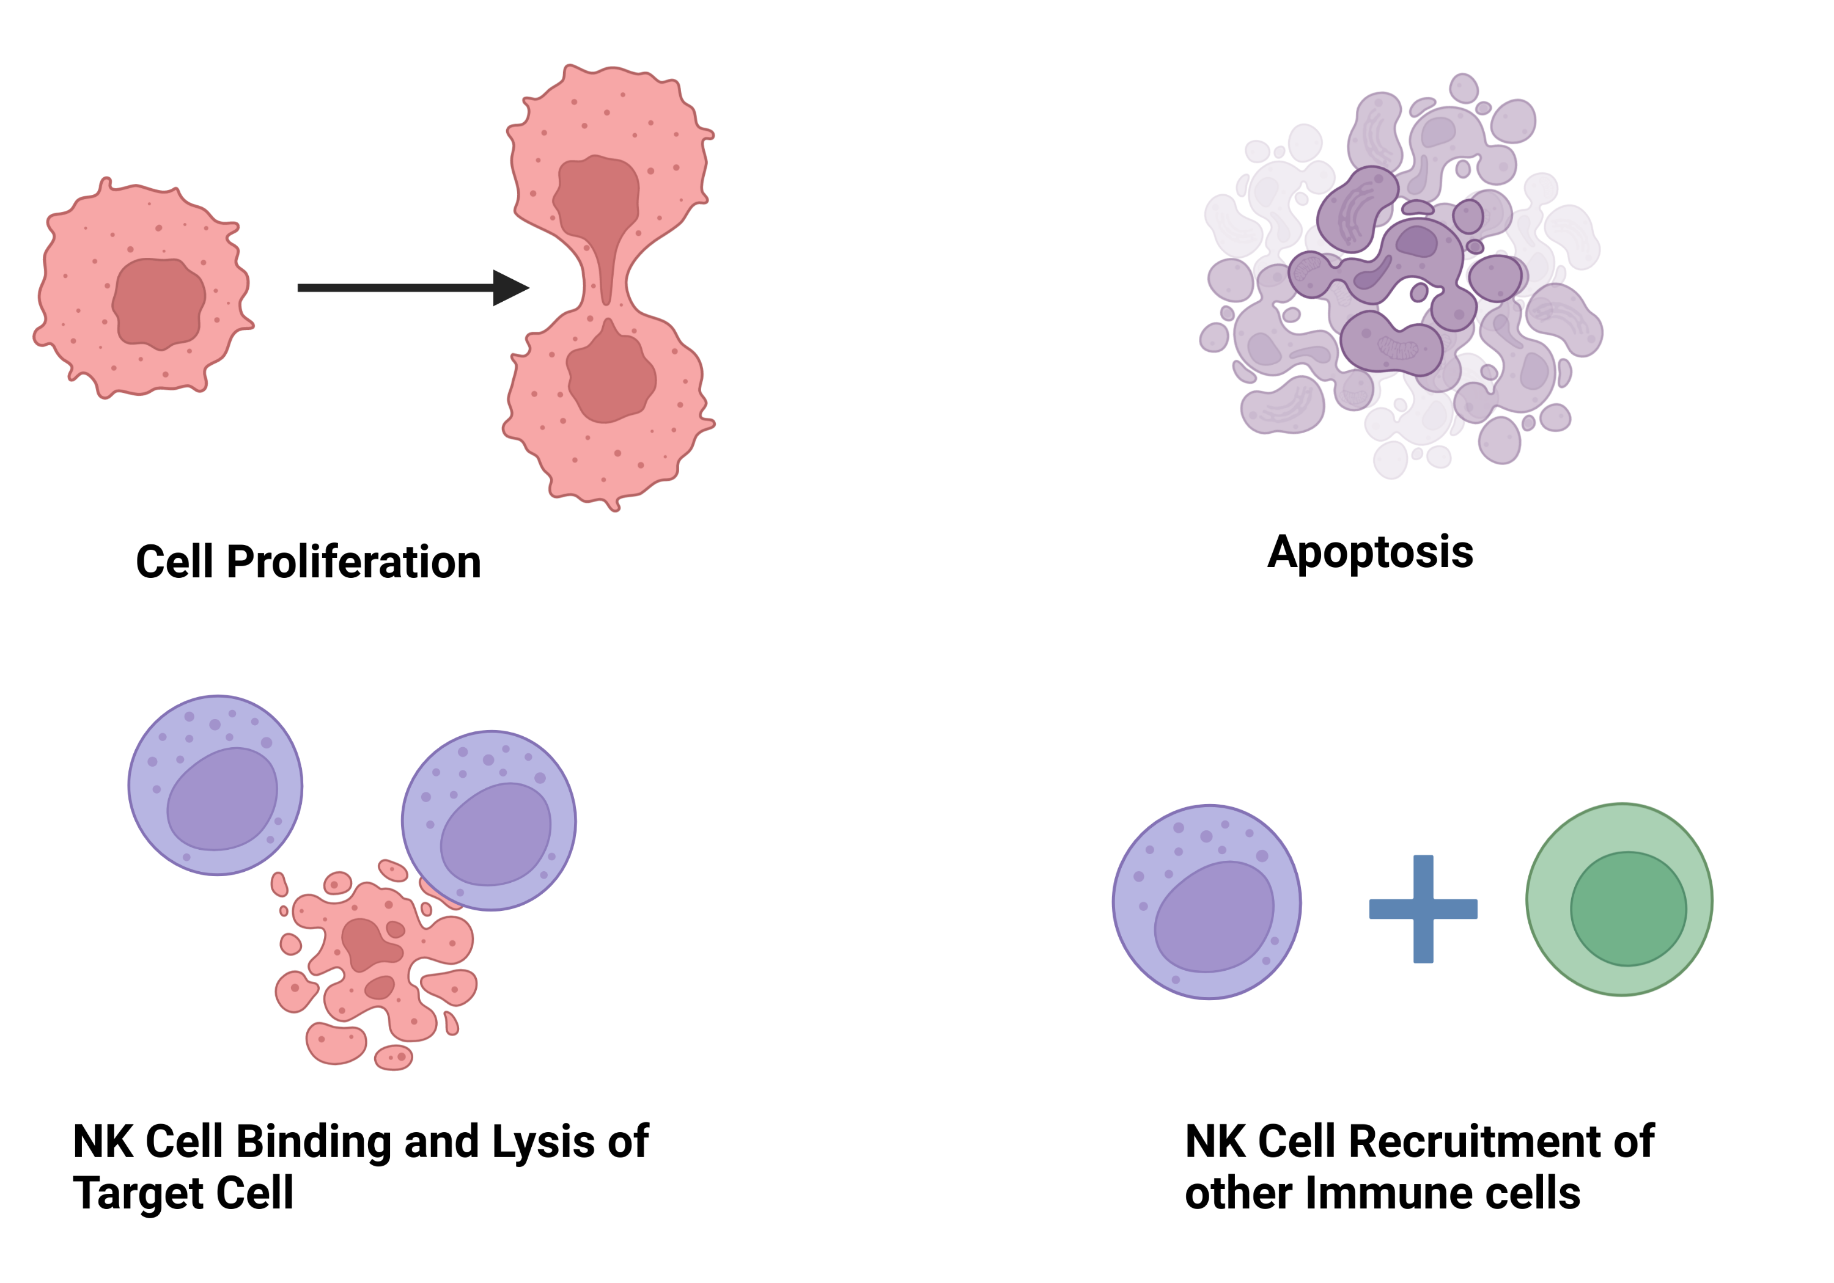
Macroscale Dynamics

Slide 8

Why Do We Care?/Project Goals
What are the key mechanisms that affect ADCC?
How much can we optimize antibody properties and dose for ADCC?
How do you model biologics on the microscale?
Given microscale parameters can we predict a macroscale outcome such as ADCC potency?
Key Parameters:
On/off rates
Valency
Receptor number/density

Slide 9
Talk Outline
Single cell antibody binding model
How to model cross-linking?
Immune synapse model
Future work

Slide 10
Ligand-receptor Model
Ligand assumed to be in excess
Multiple bindings not considered

Slide 11

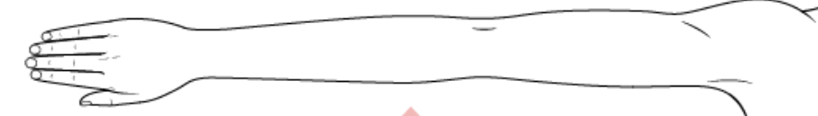

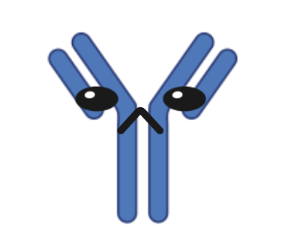
Affinity vs Avidity
Multiple bindings (avidity) results in stronger apparent overall binding strength (affinity)

Slide 12
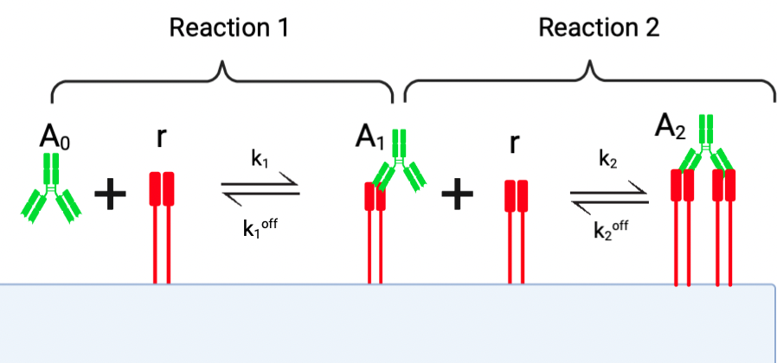

Slide 14
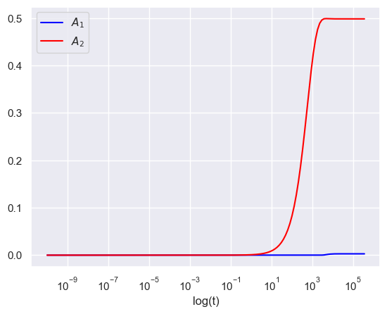
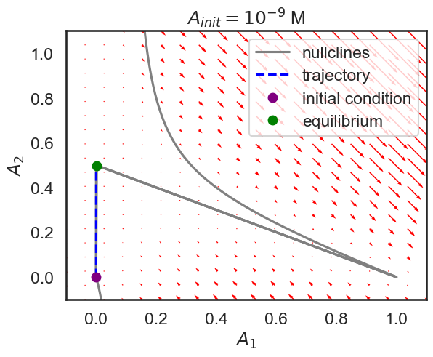
Model Dynamics

Slide 15
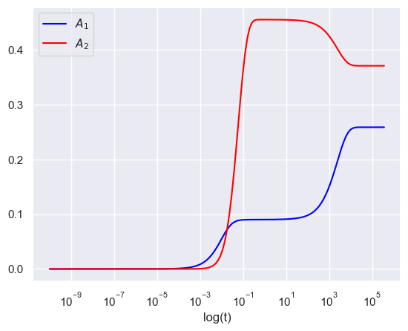
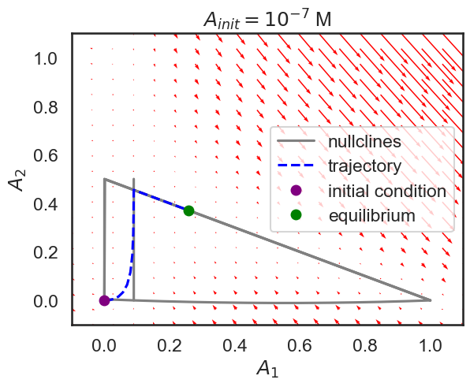

Slide 16
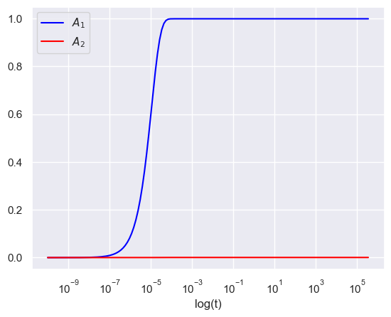
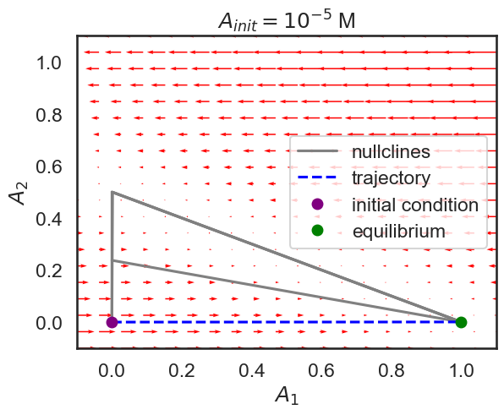

Slide 17
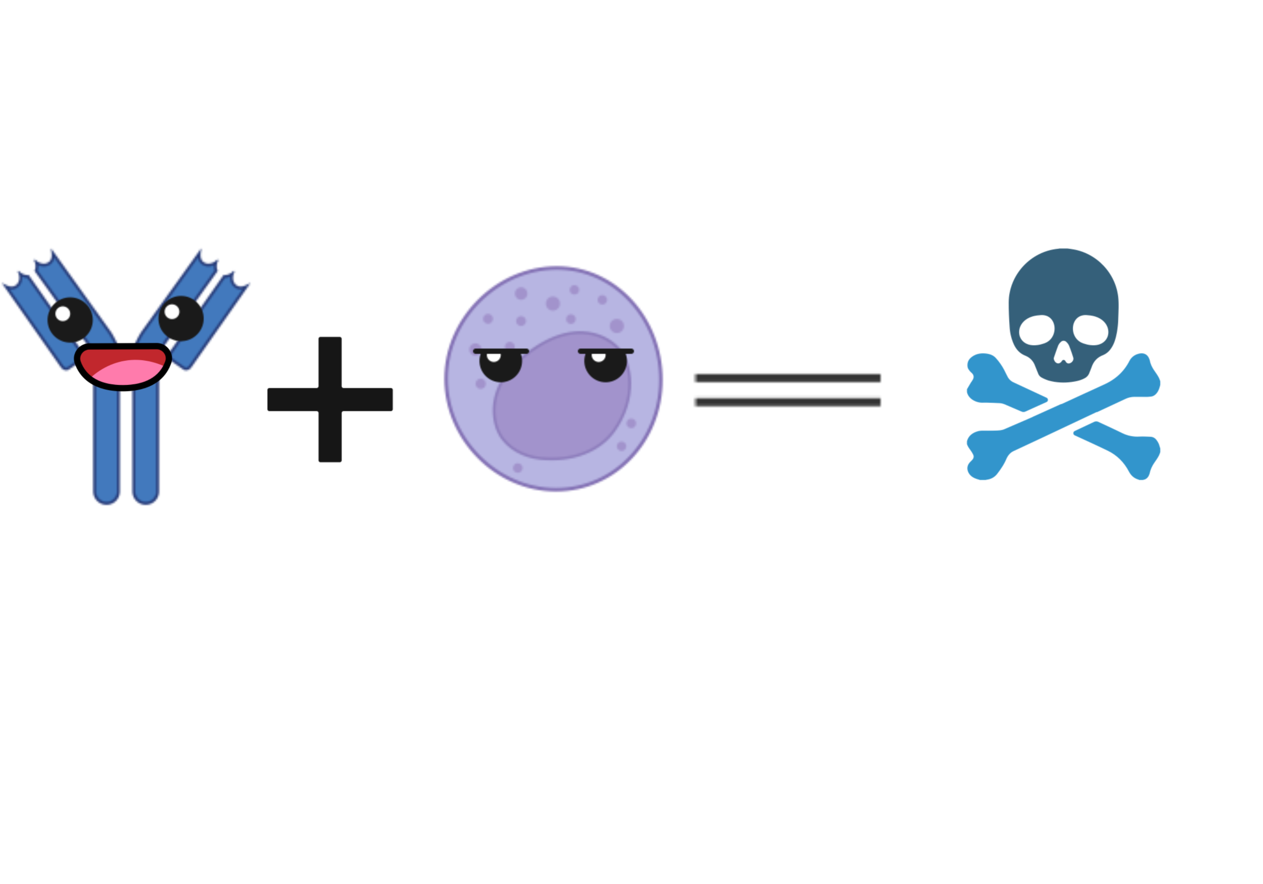

The Ratio of Antibody to Receptor Affects Binding States

Slide 18
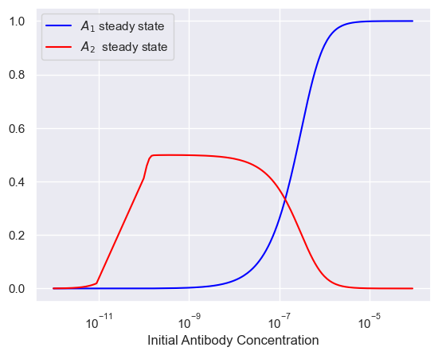
Steady States Show Different Binding Regimes

Slide 19
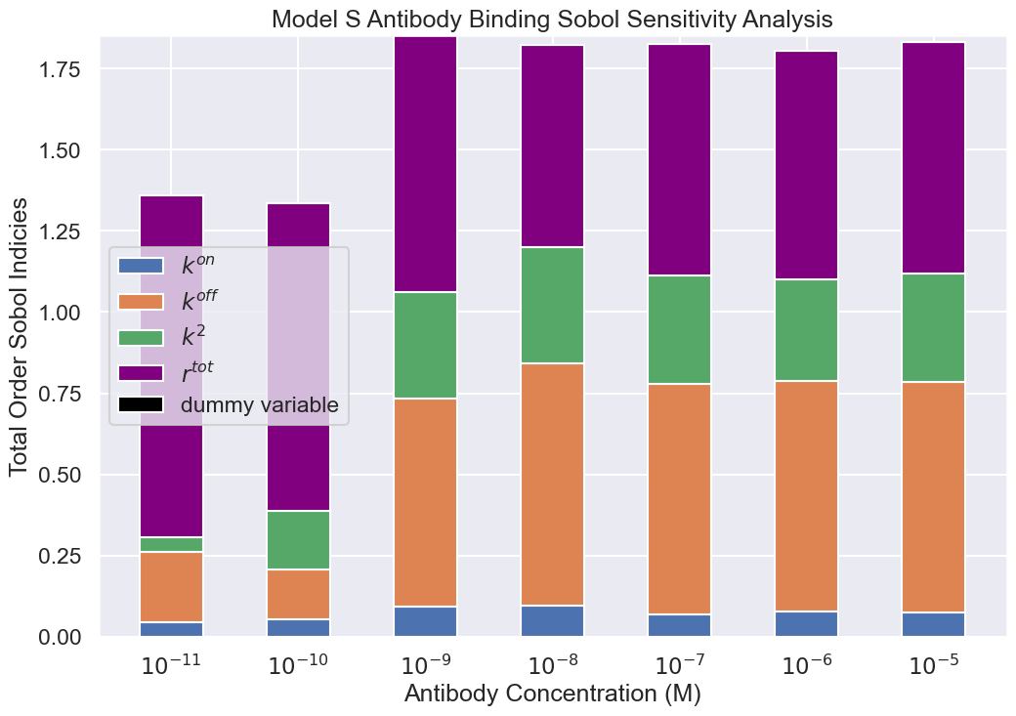
Sensitivity Analysis

Slide 20
Diffusion-limited Cross-Linking

Slide 21
Cross-linking via a Local Concentration

Slide 22
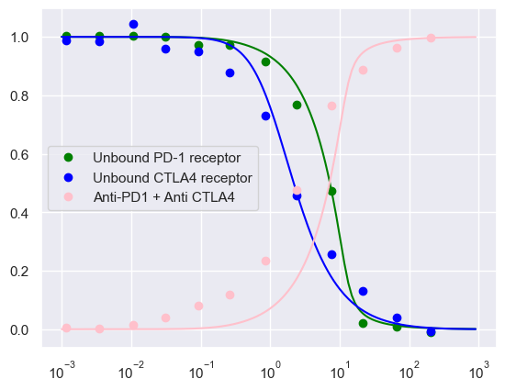
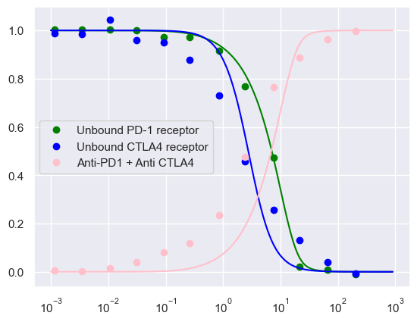
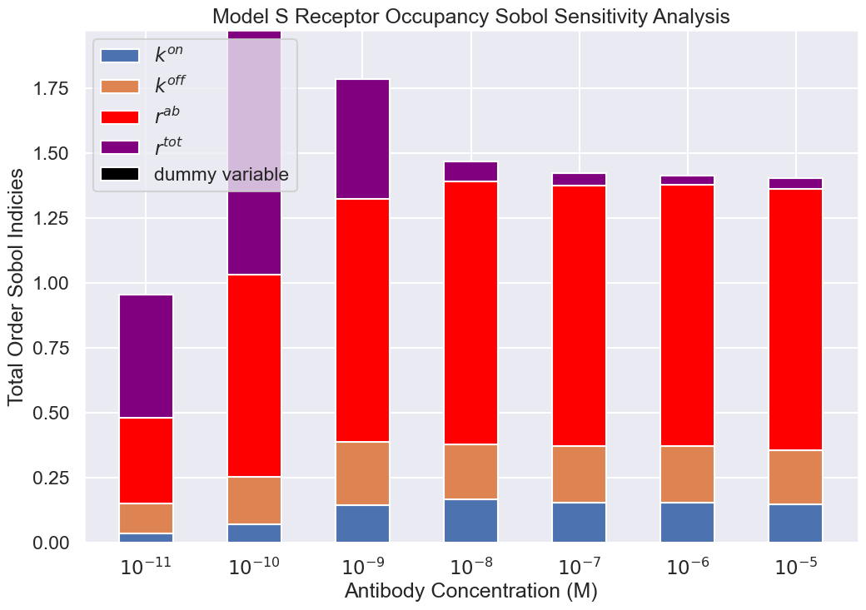
Ongoing work: Model Comparisons

Slide 23
Single Cell Summary/ Open Questions
Binding state largely dependent on antibody:receptor ratio
Sensitivity to binding kinetics dependent upon antibody: receptor ratio, what are the implications of this?
Multiple ways to model cross-binding, can we distinguish the approaches?

Slide 24
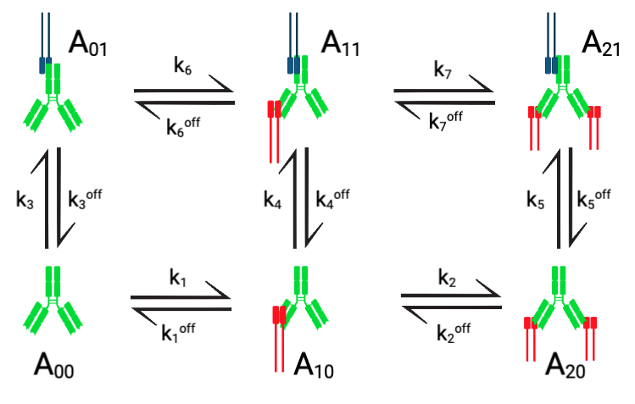
Synapse Model Schematic

Slide 25
Synapse model

Slide 26
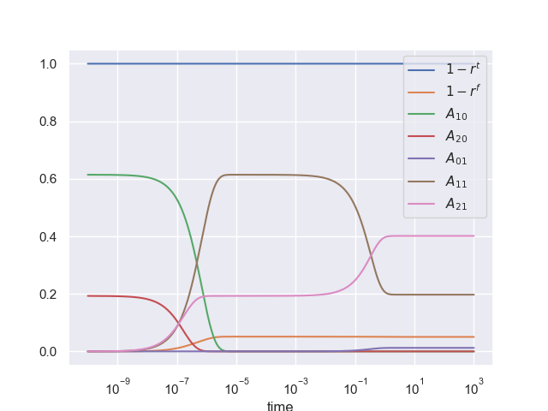
Simulations
How to extract anything from this?

Slide 27
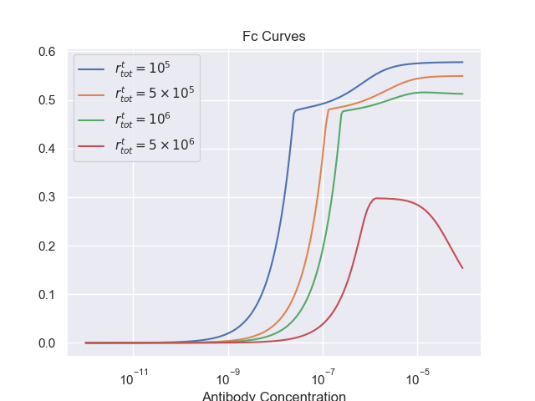
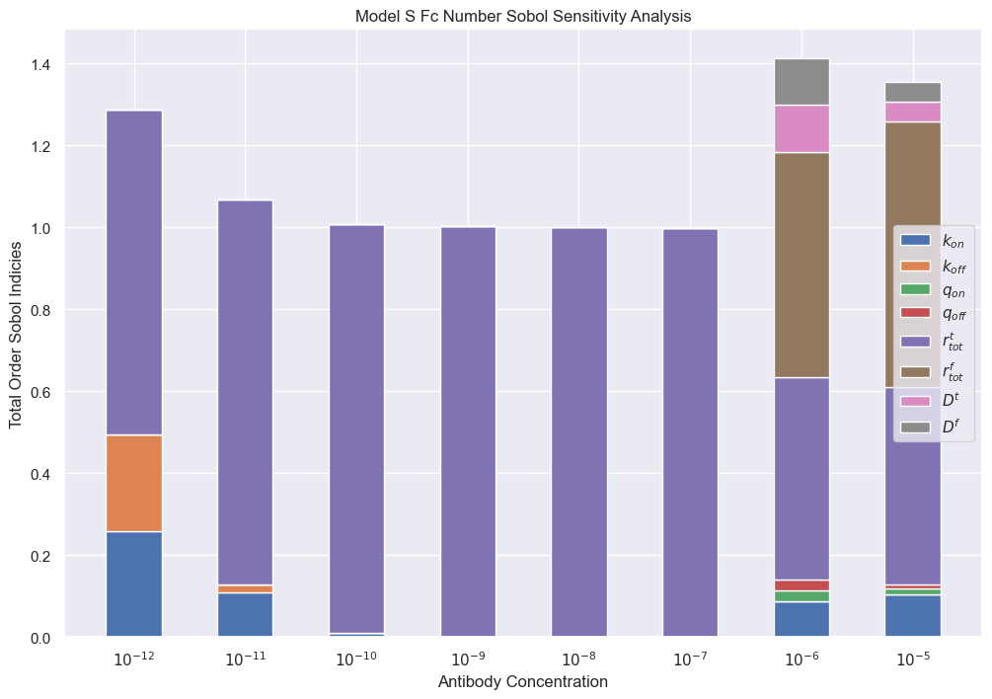
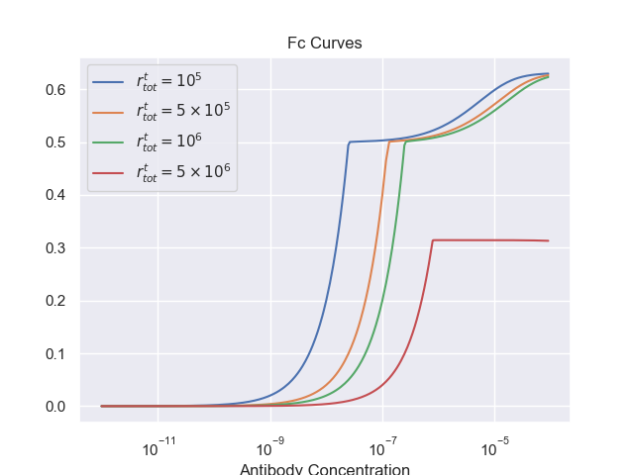
ADCC Potential

Slide 28
Future work
Asymptotic analysis
Distinguish between two cross-binding methodologies
Realistic parameter regimes for synapse model
Establish the existence or lack thereof of an optimum ADCC concentration
Best way to incorporate fc variable from synapse model into a multiscale model of ADCC?

Slide 29
Thank you for listening
Special thanks to Josh for being an amazing office mate

